Slide 1

AML-2304 Natural Language Processing
Lambton College
School of Computer Studies
[Prepared By: Vahid Hadavi, PhD]

Slide 2
Module 2 2. Evaluate the application of NLP in various Canadian businesses
Major Topics:
2.1 Discuss the usage of NLP in Customer Service
2.2 Describe how NLP is used in Market Intelligence
2.3 Discuss the applicability of NLP for Sentiment Analysis

Slide 3
2.1 Discuss the usage of NLP in Customer Service

Slide 4


Customer Service
Definition
The support offered to customers, both before and after they buy and use products or services, that help them have an easy and enjoyable experience.
Based on Call Center research
25% of customers pay more for better customer experience.
64% of consumers expect real-time responses at any time.
62% of customers consider switching to a competitor after only 1-2 bad experiences.

Slide 5

NLP in Customer Service
Chatbots
Use of chatbots in customer service industry is
growing; 85% of all customer interactions.
Based on the estimations, 40% of consumers
do not care whether a chatbot or a real human
helps them, if they are getting the help.
With NLP:
Chatbots will be able to handle increasingly complex consumer communications.
Make personalization possible. Chatbots will be able to remember past conversations with users to customize questions, responses, and options.

Slide 6
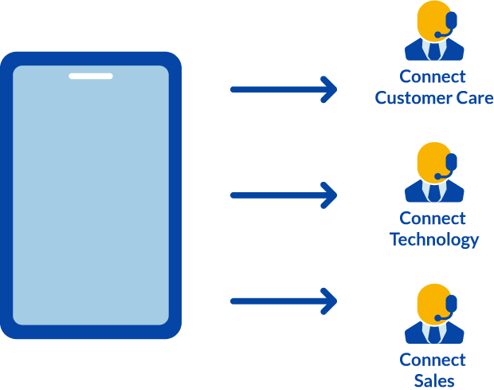
NLP in Customer Service
IVR technology
Interactive Voice Response
Ask callers specific questions and route them through pre-programmed paths
With NLP:
Callers tell the system what they need in their own words.
No need to use certain phrases and speak in a stiff manner.
Possible for the system to ask open-ended questions.
Understands context in replies.
Responds to caller requests to repeat something or pause.

Slide 7
2.2 Describe how NLP is used in Market Intelligence

Slide 8
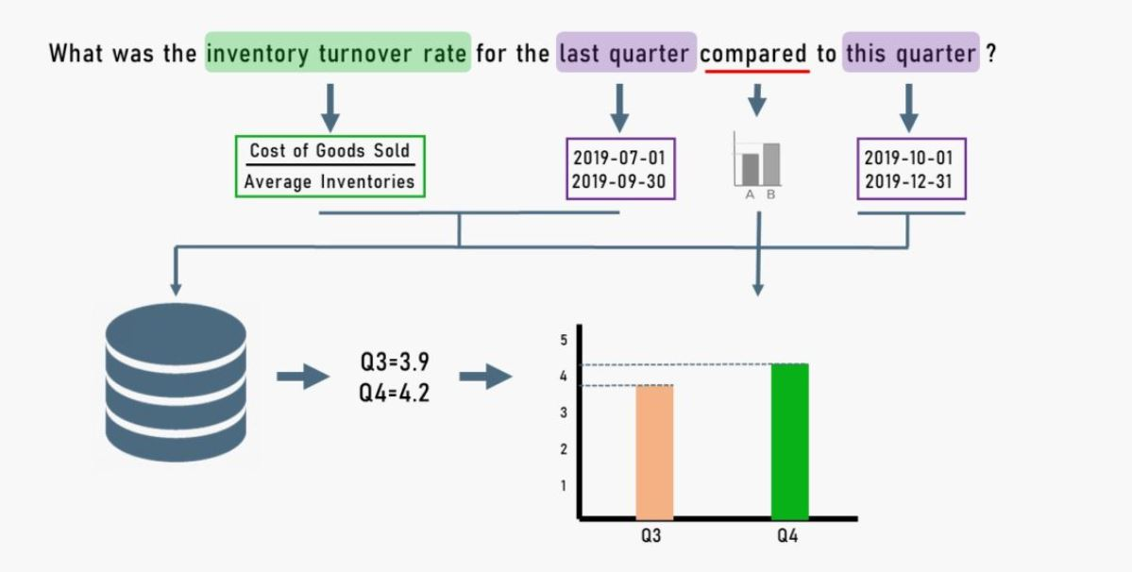
Market Intelligence with NLP
Most business markets are much impacted and influenced by market knowledge and information exchange among various companies, stakeholders and governments.
NLP is a great tool for monitoring market intelligence reports to extract new information that can help businesses to produce new strategies.
It empowers more users to explore and manipulate data in search of valuable insights, the more likely those insights will lead to better business decisions.

Slide 9
2.3 Discuss the applicability of NLP for Sentiment Analysis

Slide 10
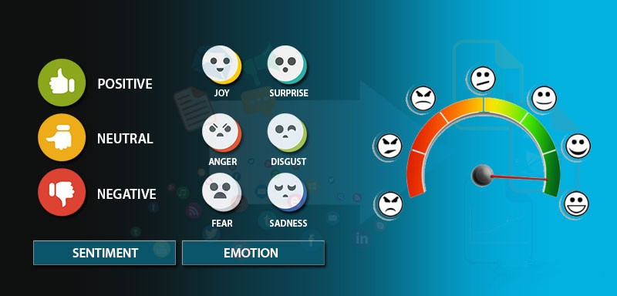
Sentiment Analysis
Definition
Sentiment Analysis is the process of determining whether a piece of writing is positive, negative or neutral.
Use cases and applications
Social media monitoring
Brand monitoring
Voice of customer
Customer service
Market research

Slide 11
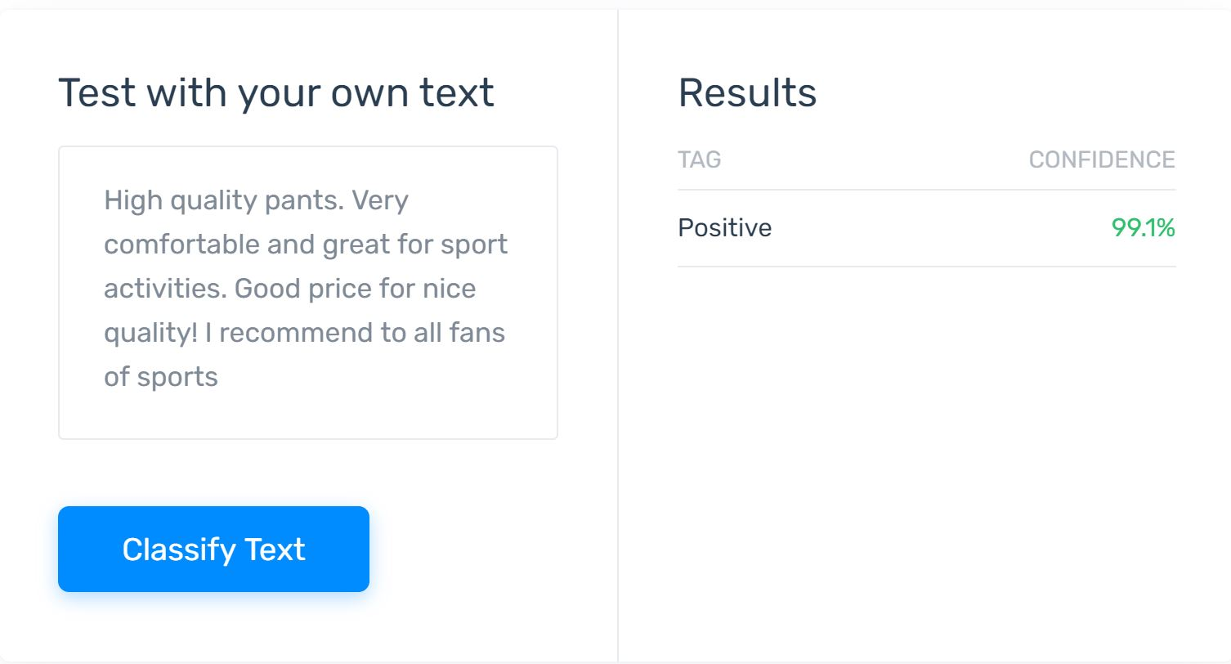
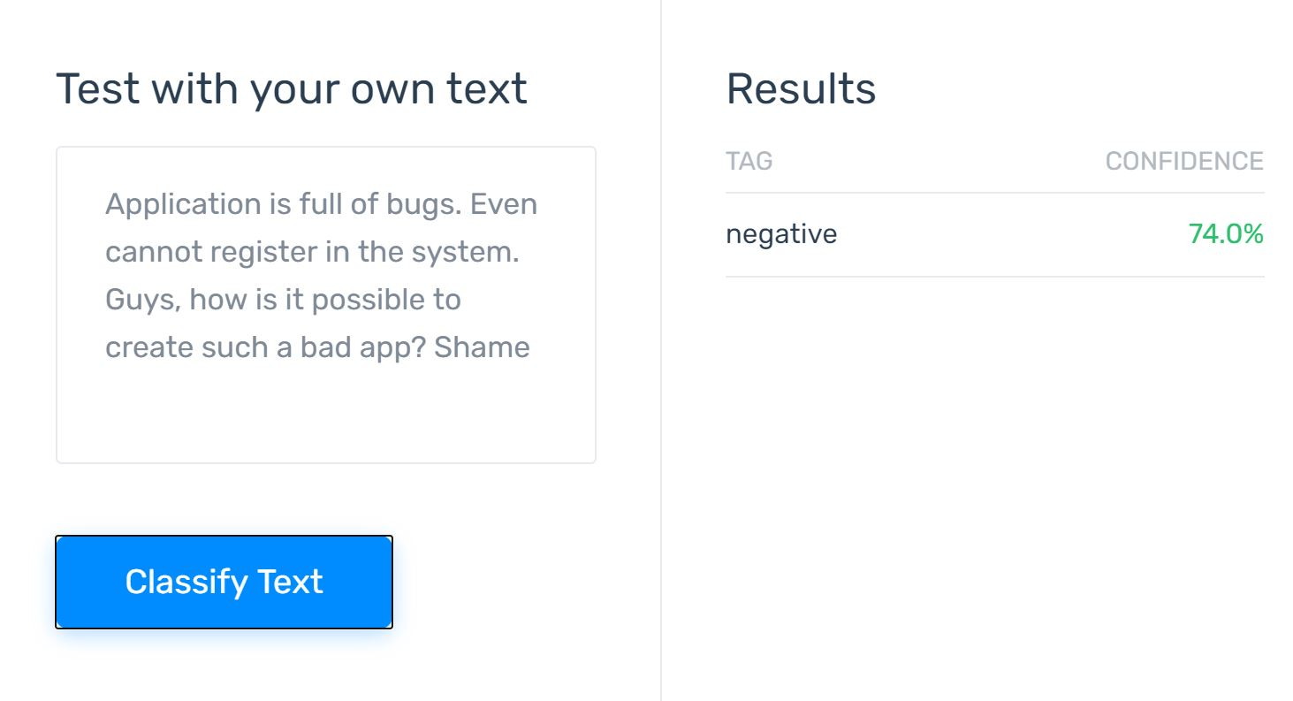
Sentiment analysis with NLP
One of the most popular applications of NLP.
Key aspect of sentiment analysis is to analyze a body of text for understanding the opinion expressed by it.
We quantify this sentiment with a positive or negative value, called polarity.
We can analyze the sentiment of large texts, or thousands of reviews and extract keywords with high accuracy.

Slide 12
Any questions so far? Any comments?

